Slide 1
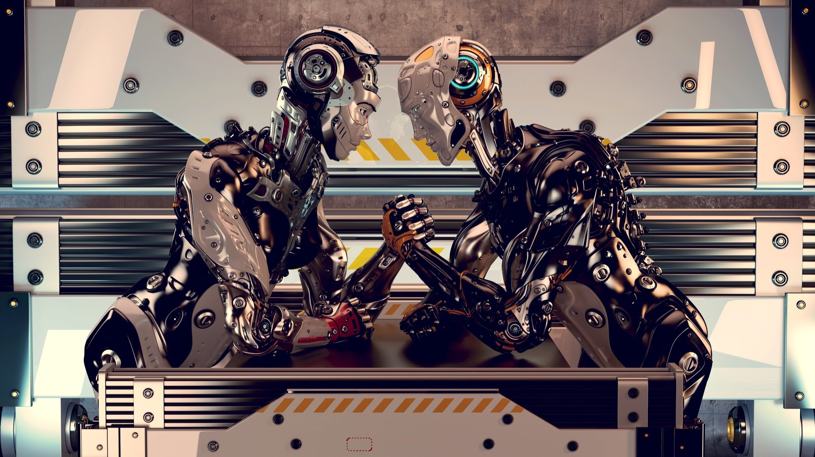
Introduction
Title: Robots vs Wrestlers
Game designer: R-bjorn
Overview of the game development process

Slide 2
Introduction
Title: Robots vs Wrestlers
Game designer: Ravi Trivedi
Overview of the game development process

Slide 3
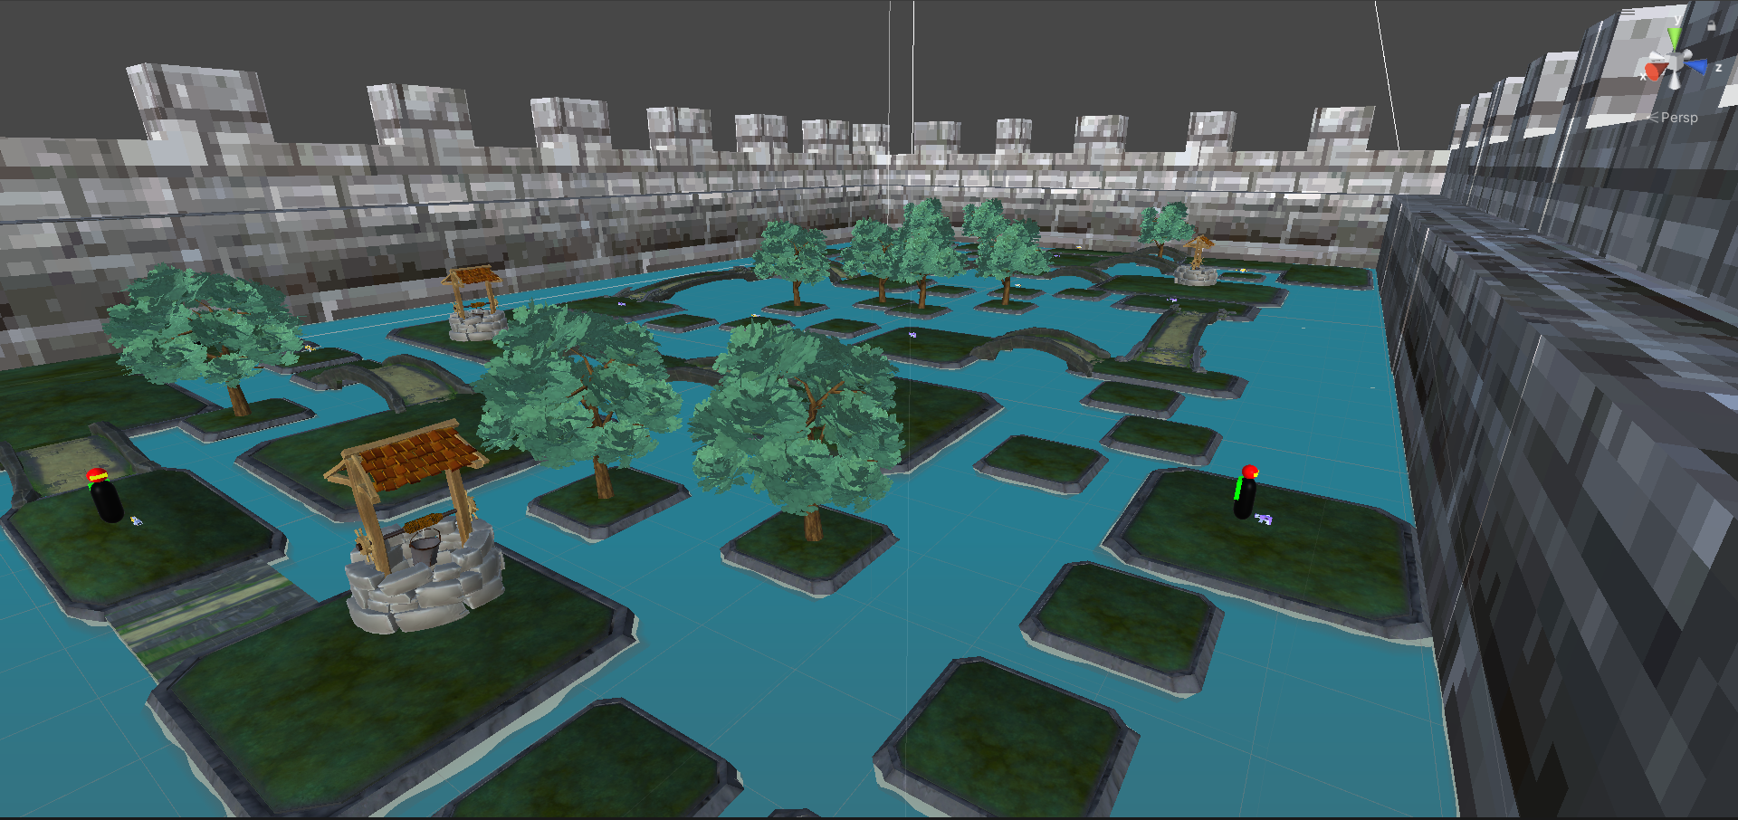
Level Design
This is the level design of the game
The level contains Robots roaming around the level
There are health stations where wrestler needs to move and hold in order to increase their health
There are weapon pickups throughout the level scene, can be picked up by either a Robot or a Wrestler.
Both characters needs to jump from one tile to another in order to move around and cannot walk on water surface.

Slide 4
Level Design
NavMesh for Unity
Advantages of using Navmesh: more efficient agent movement, more precise pathfinding, and easier AI development
Explanation of A* Pathfinding algorithm, which is used by Navmesh to calculate the shortest path between two points
Links to Navmesh Unity resources:
https://docs.unity3d.com/Manual/UnityManual.html
https://youtu.be/CHV1ymlw-P8

Slide 5
Level Design
Networking
I am using Unity’s Netcode (Multiplayer using GameObjects) and Multiplayer tools.
Server – hosts a server for the level game
Host – Adds a player prefab with the server
Client – Adds a client to the server

Slide 6
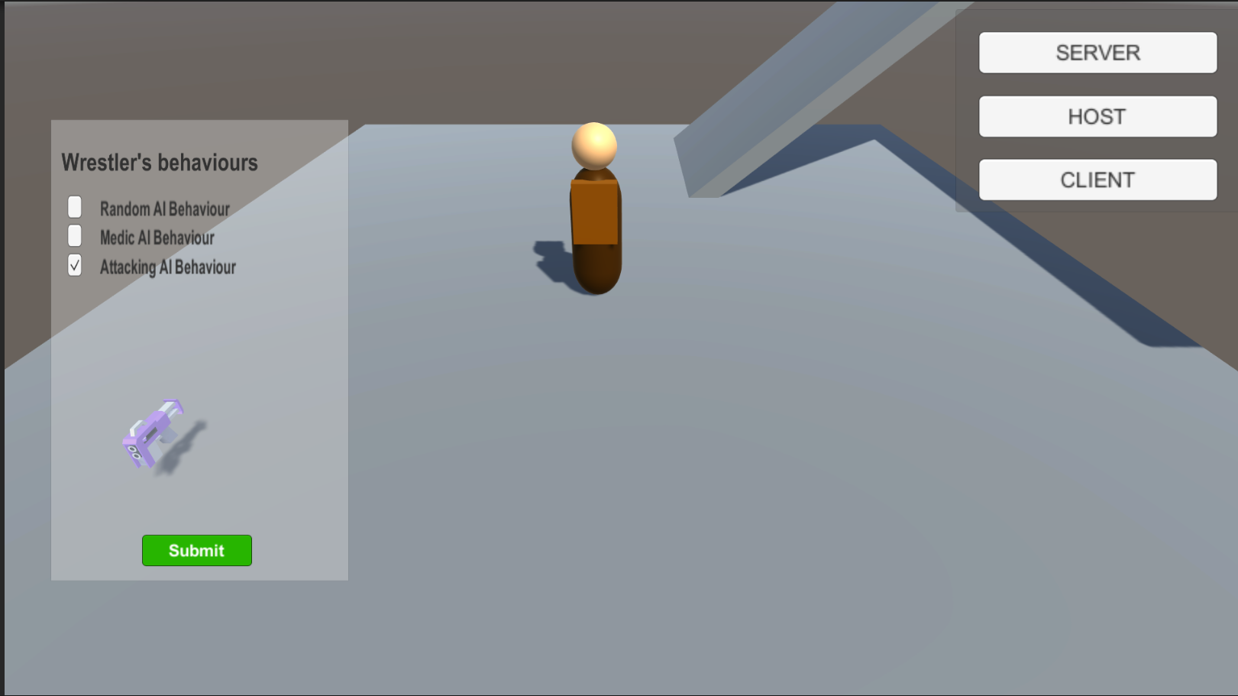
Wrestler UI
Added a basic UI for players to change the behaviour of their agent.
Agent has 3 behaviours
Random AI (Random Movement)
Medic AI (Prioritize restoring health)
Attack AI (Getting a weapon and attacking enemy)

Slide 7
Conclusion
Now, It’s time to play the game together
Any Questions before we start?
Wrestler UI
Added a basic UI for players to change the behaviour of their agent.
Agent has 3 behaviours
Random AI (Random Movement)
Medic AI (Prioritize restoring health)
Attack AI (Getting a weapon and attacking enemy)

